Slide 1
National Schools Twenty20 competition
Finals day Sunday June 27th 2021
Arundel Castle cricket ground

Slide 2
Photographs
by
Patrick Eagar
© No images may be reproduced without permission

Slide 3
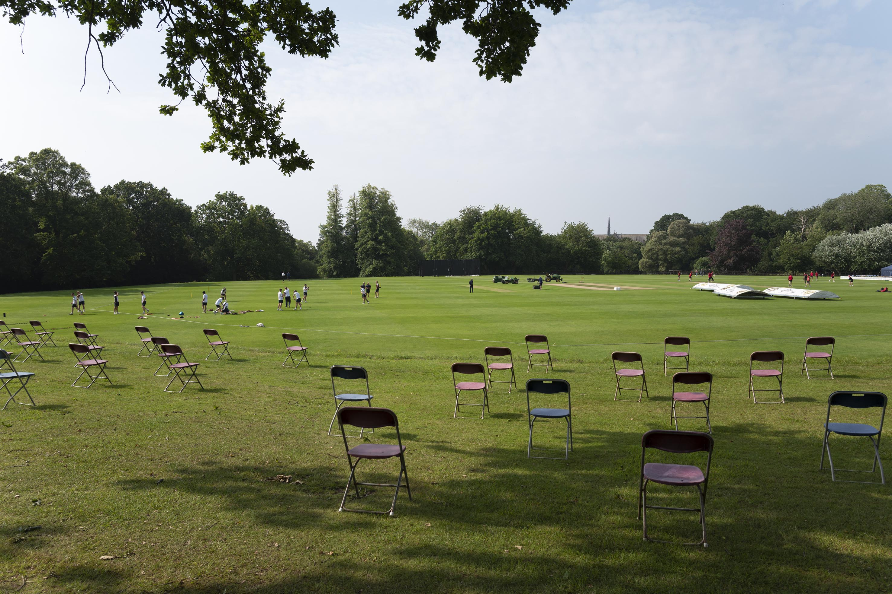
Arundel in the time of Covid 2021

Slide 4
The first semi-final
Sedbergh v King’s Taunton
Sedbergh in brown
King’s in black and red

Slide 5
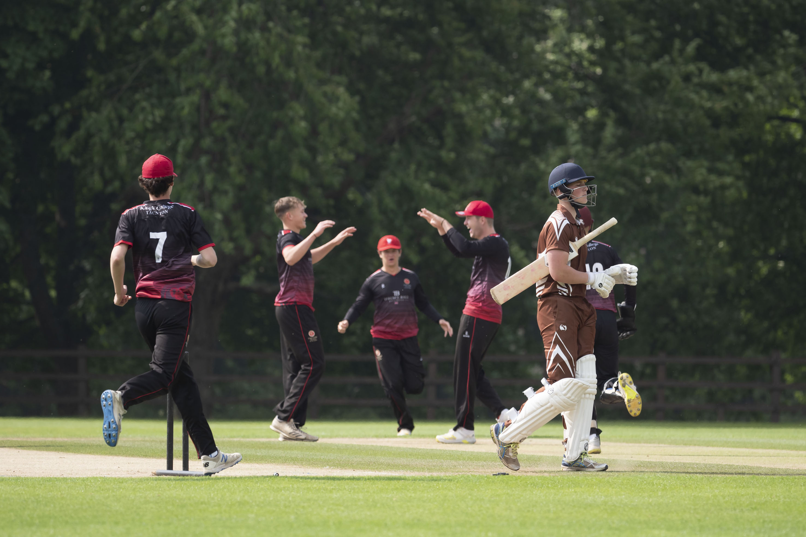
Evan Williams bowled by Henry Smeed in the first over

Slide 6
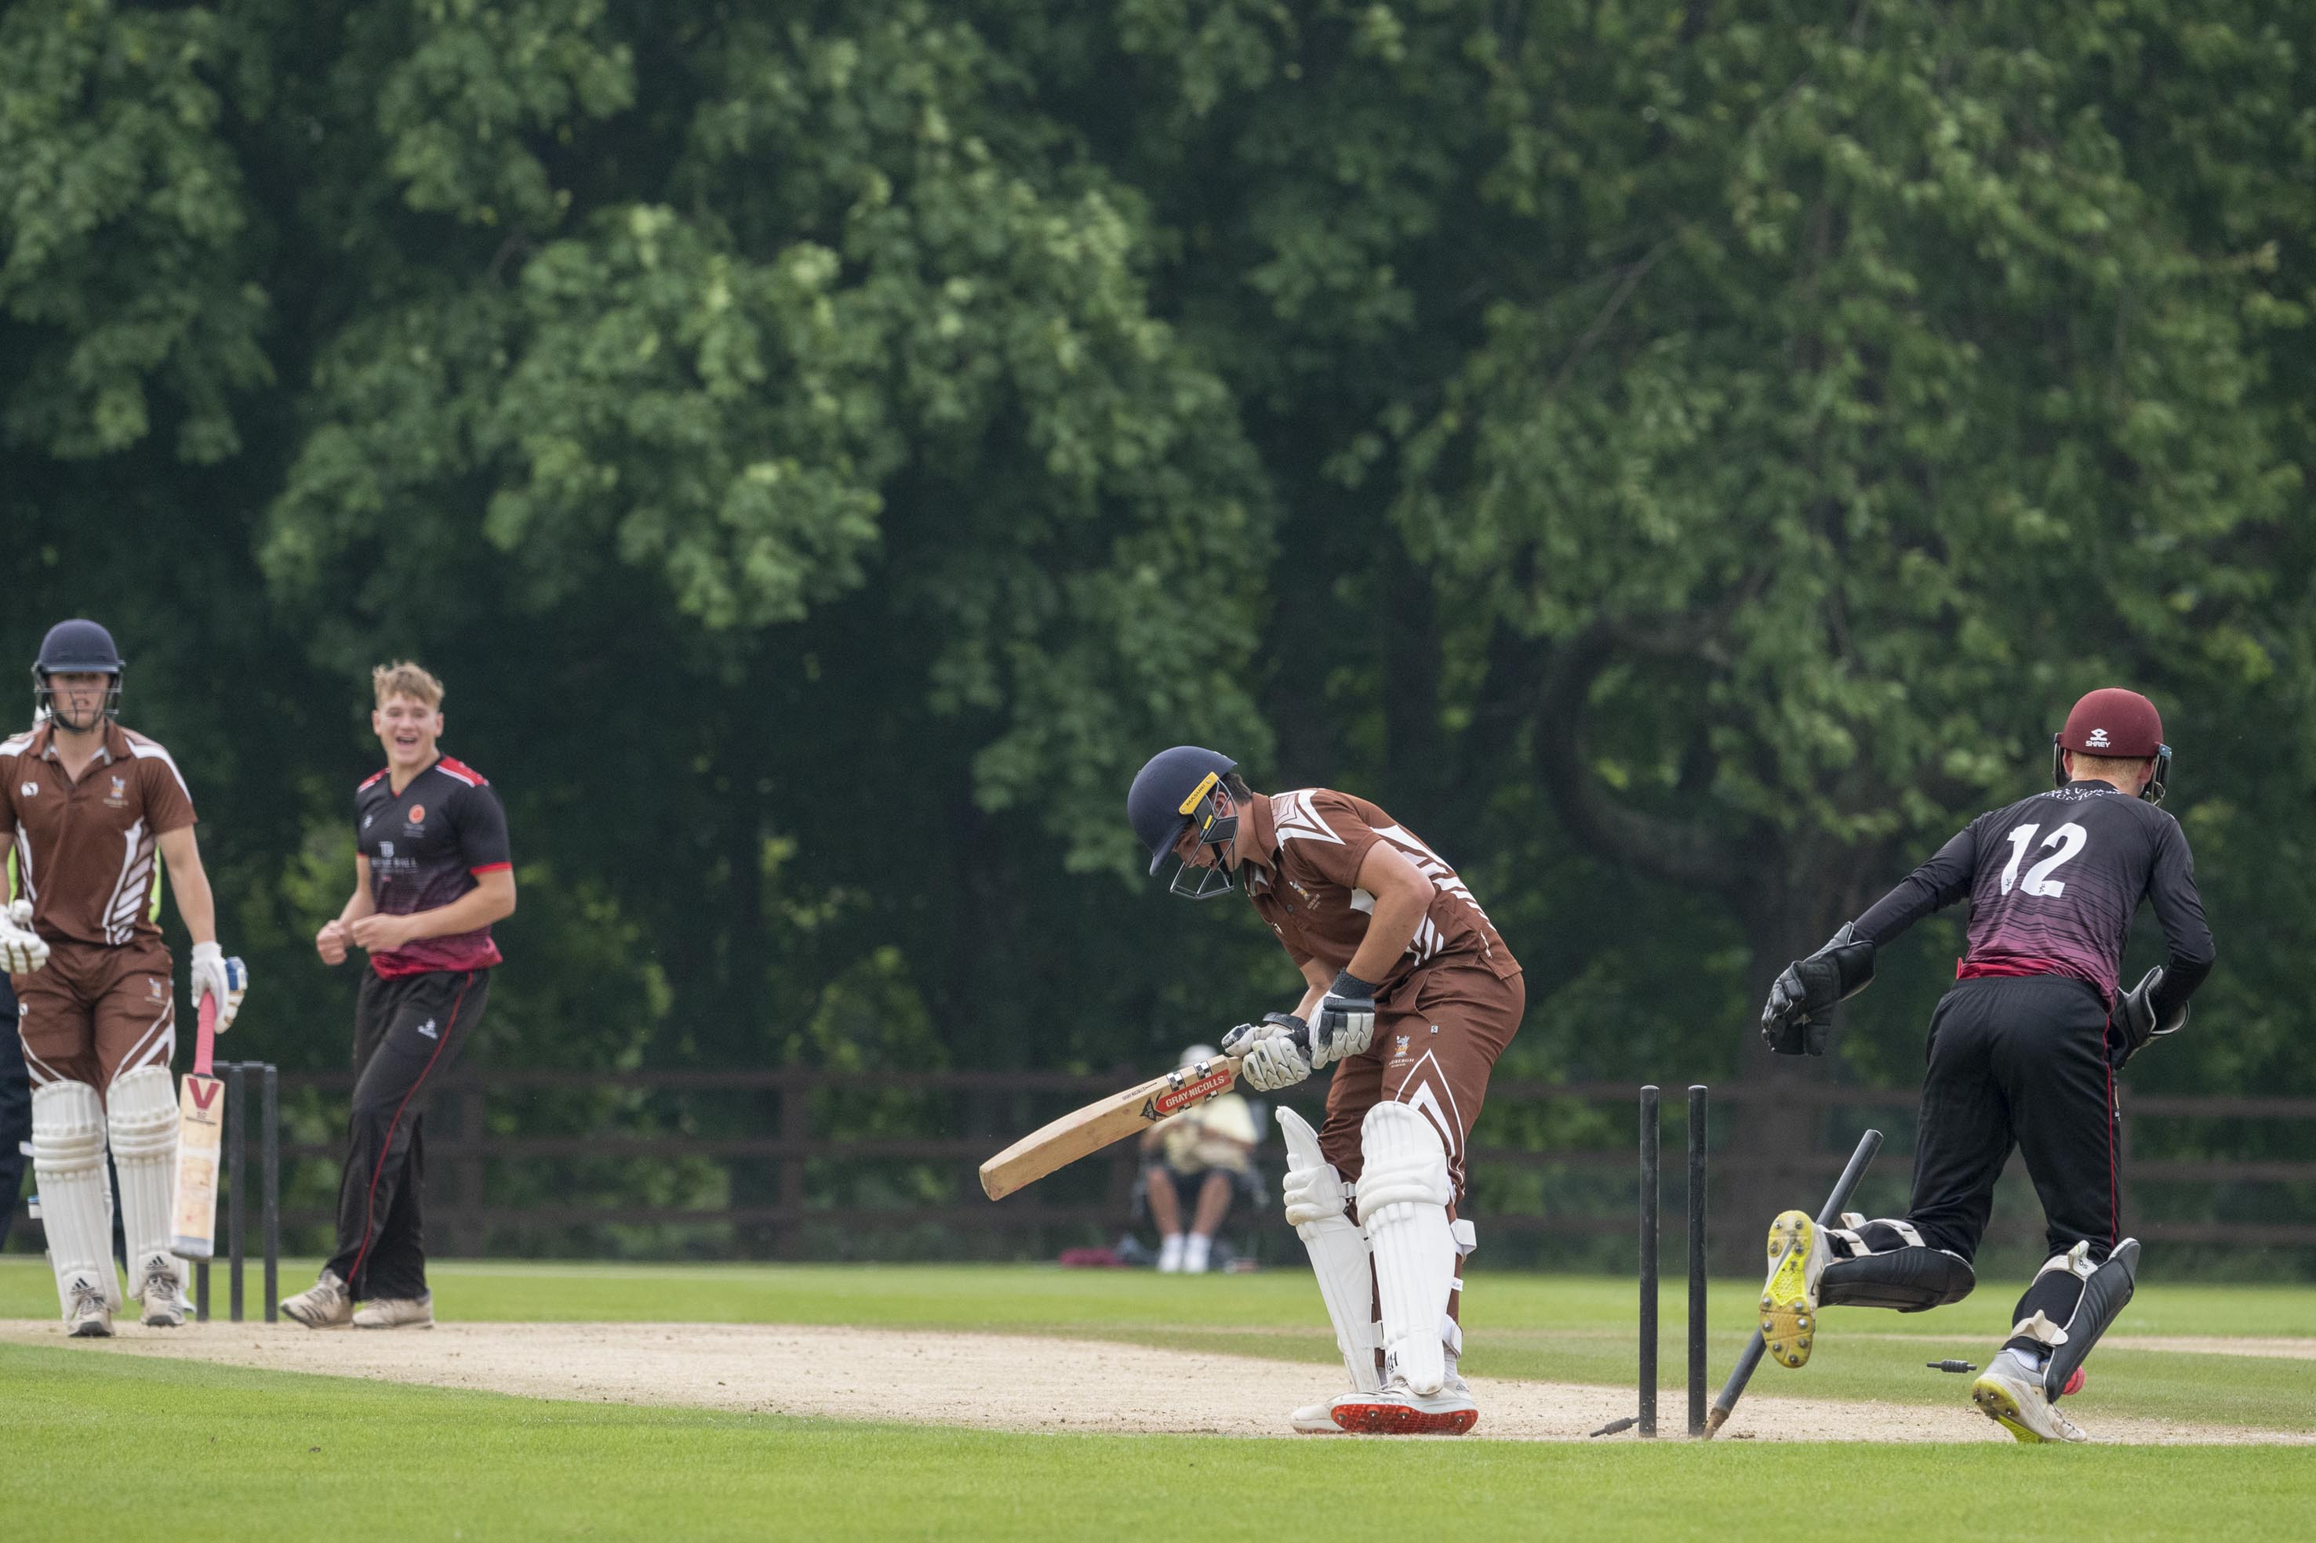
George Barnes, Sedbergh, bowled by Henry Smeed

Slide 7
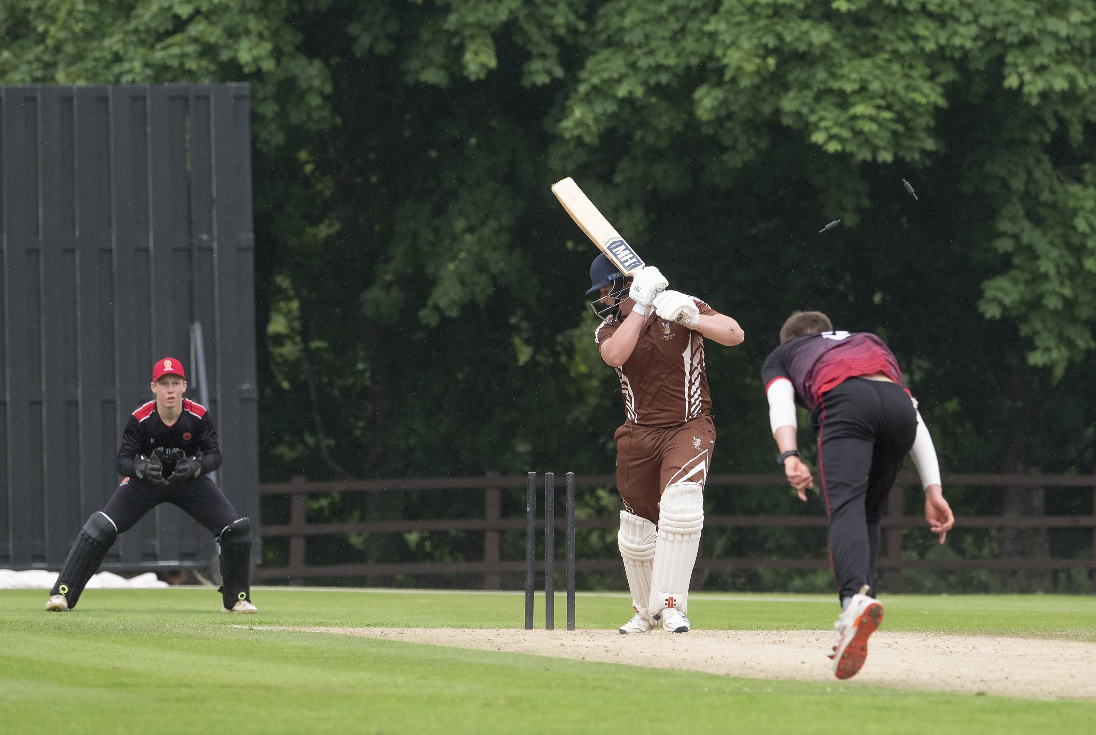
Ben Wright bowled by Sonny Baker

Slide 8
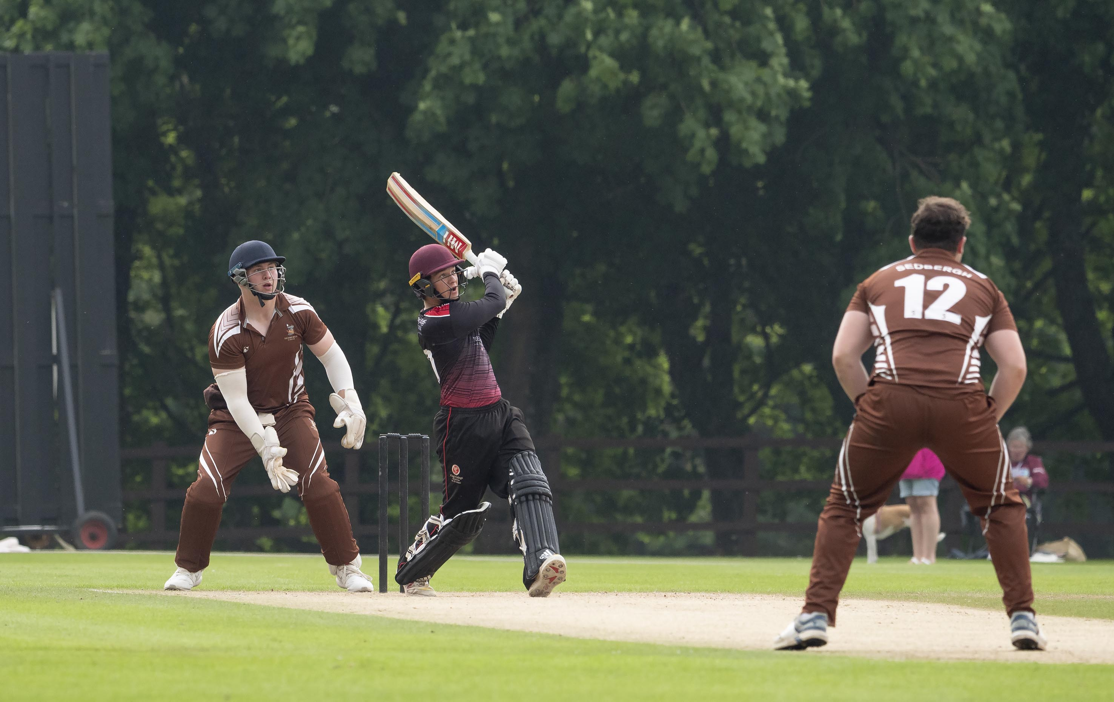
Taylor Ingham-Hill hits Sedbergh’s Ben Wright during his 10

Slide 9
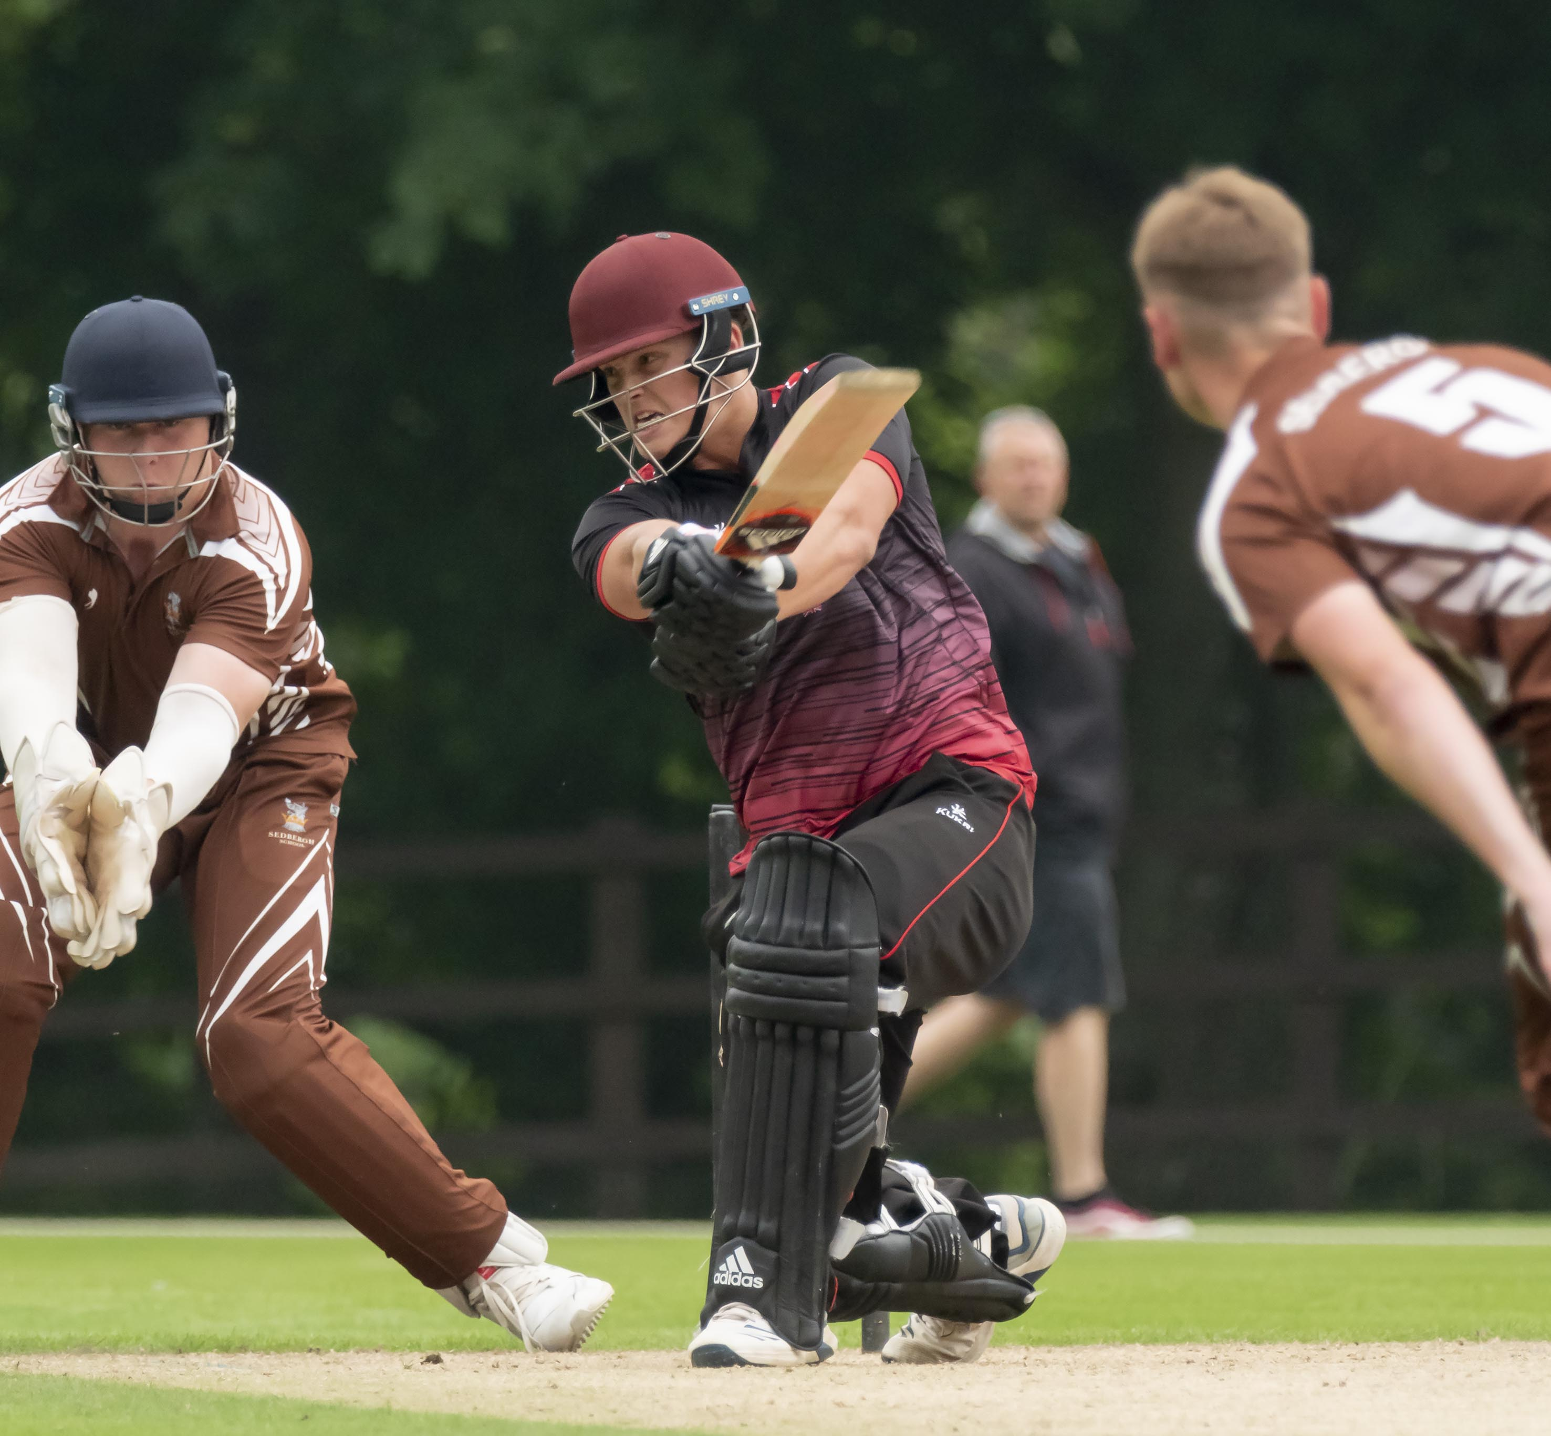
George Thomas (King’s) drives Evan Williams (Sedbergh)

Slide 10
The second semi-final
Malvern v Tonbridge
Malvern in green
Tonbridge in blue

Slide 11
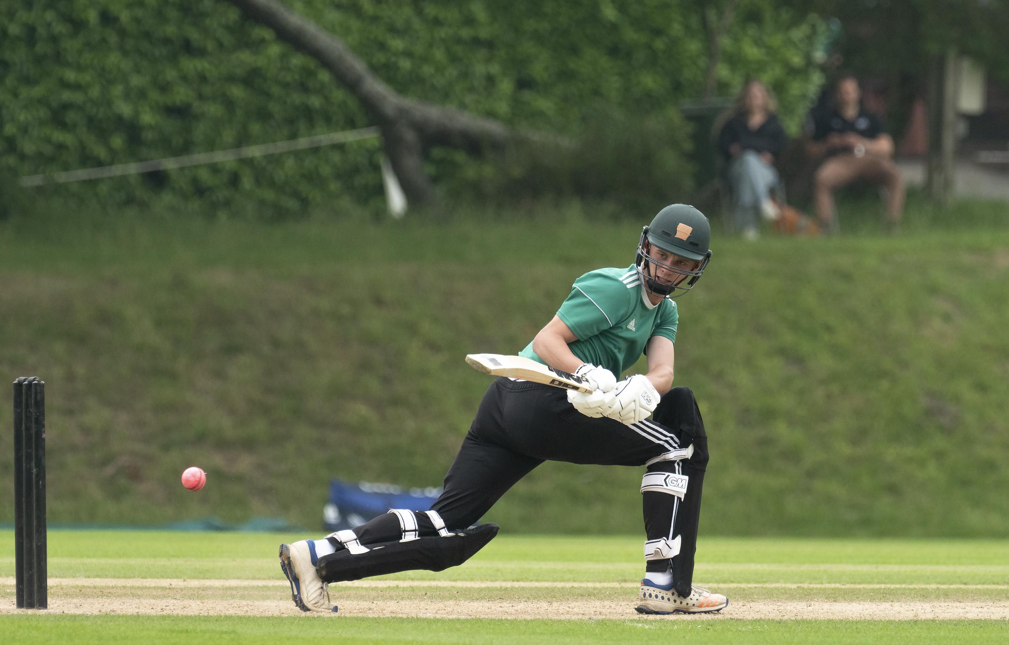
Josh Dickenson, the Malvern captain who made 6

Slide 12
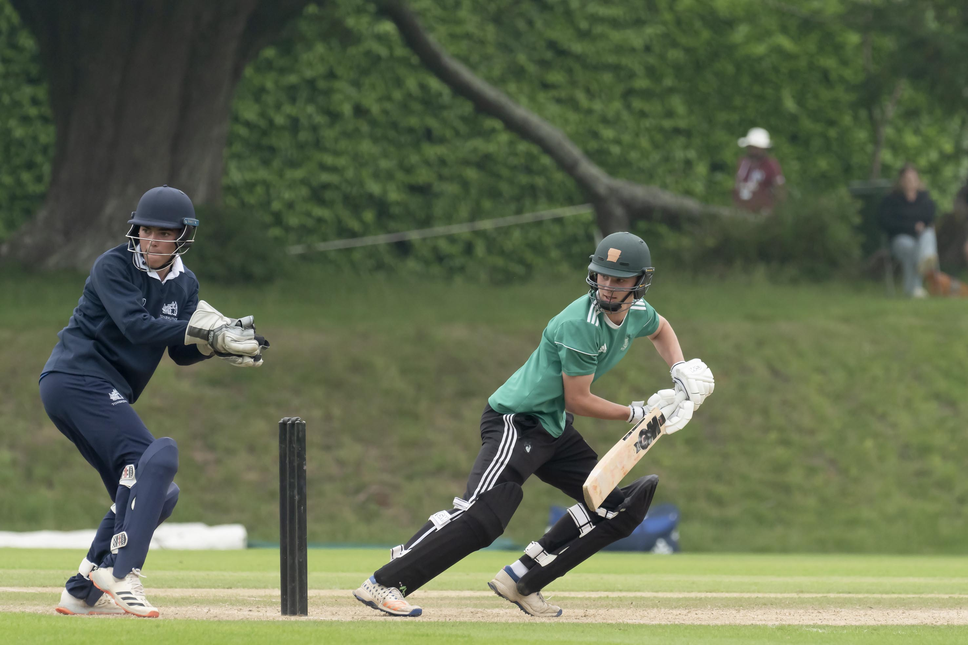
Josh Dickenson (Malvern captain) batting and Tom Geffen (Tonbridge captain) wicket-keeper

Slide 13
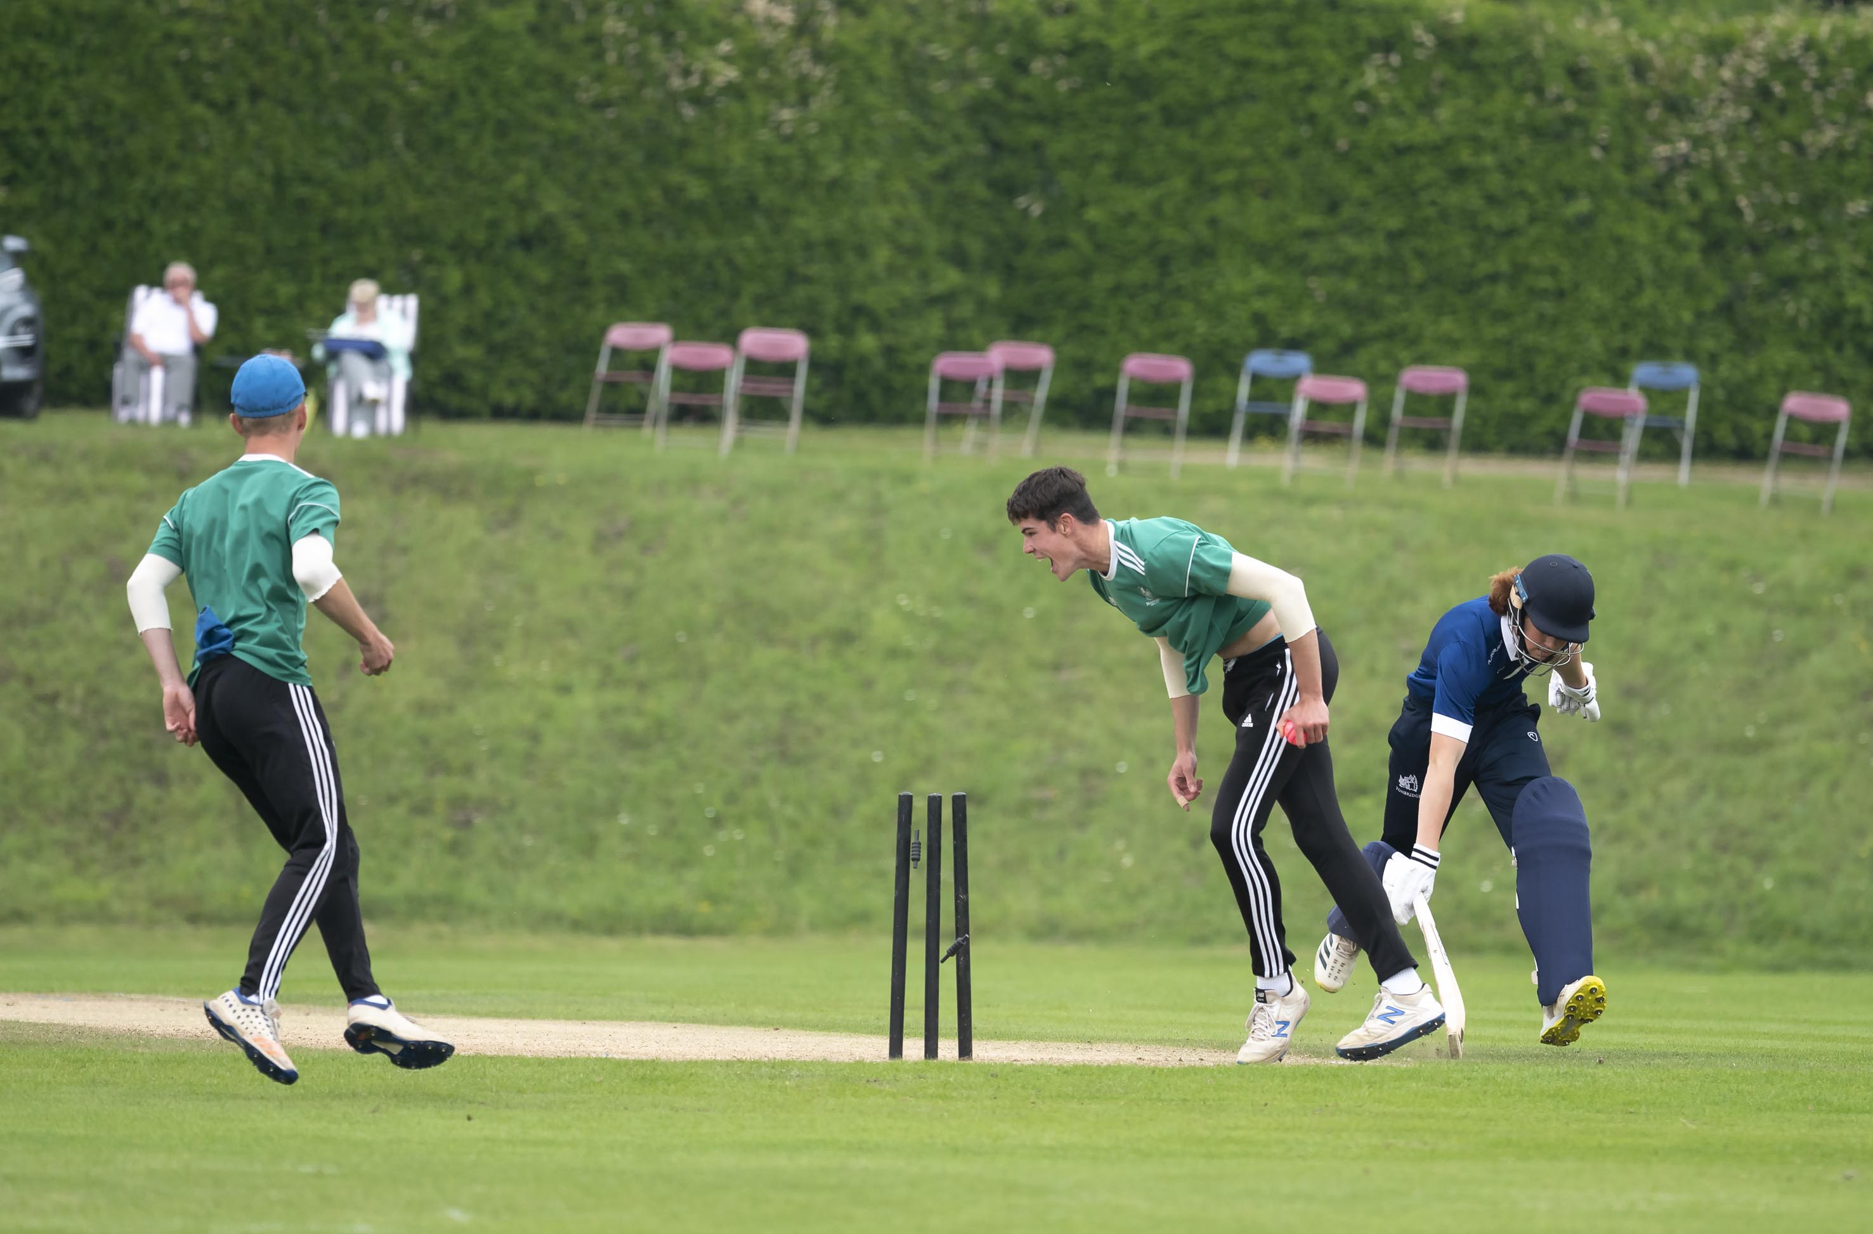
Ollie Sykes is run out

Slide 14
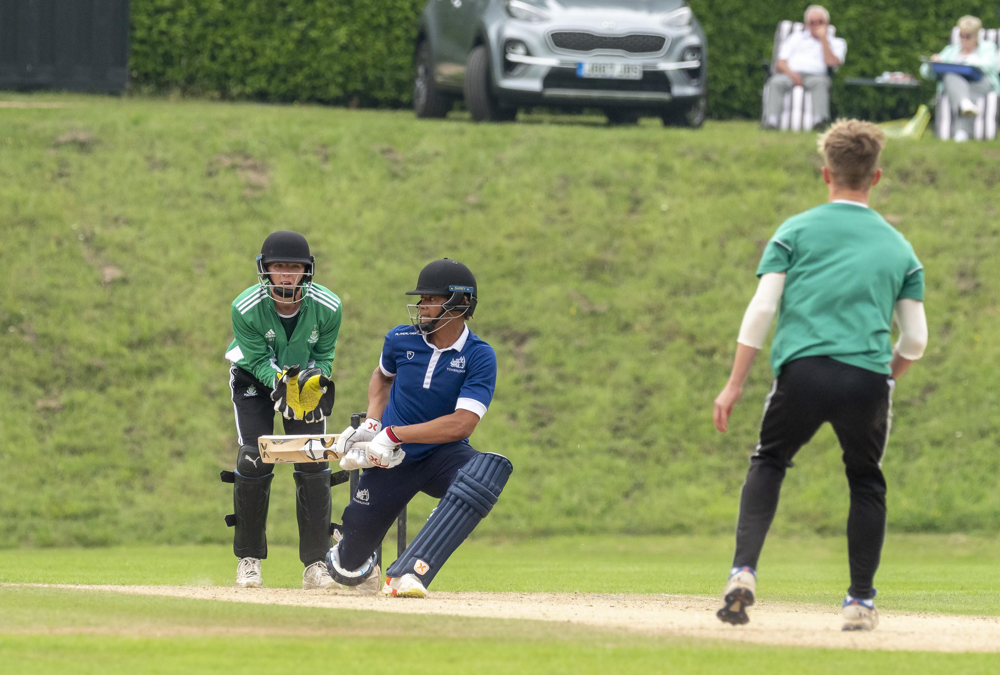
Sam Hadfield reverse sweeps during his 55

Slide 15
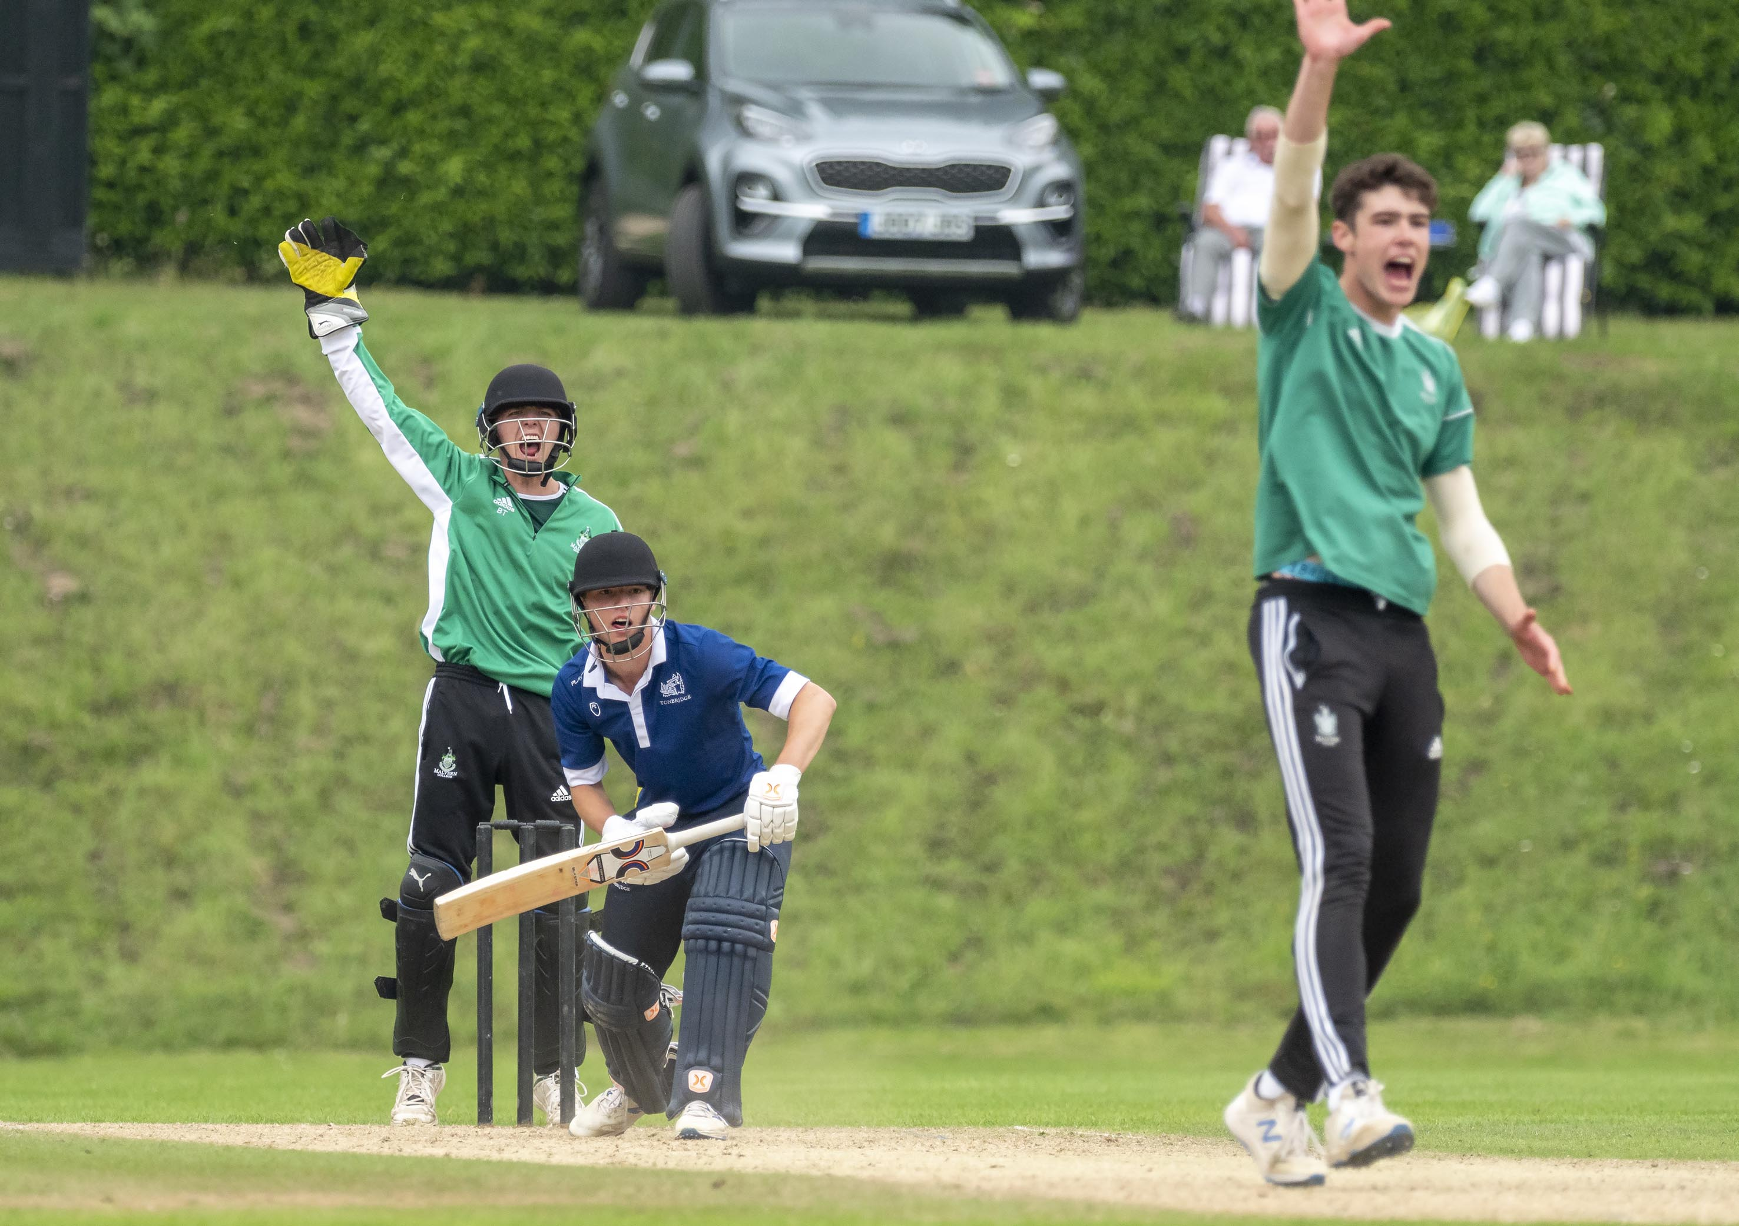
Joe Baldwin lbw Josh Baker

Slide 16
The final
Malvern v King’s Taunton
Malvern in green
King’s in black and red

Slide 17
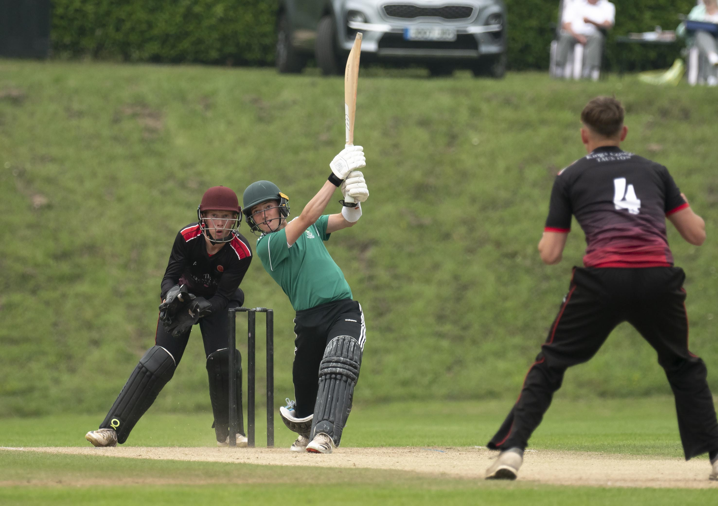
Oliver Cox who made 12 hits Henry Smeed to the boundary

Slide 18
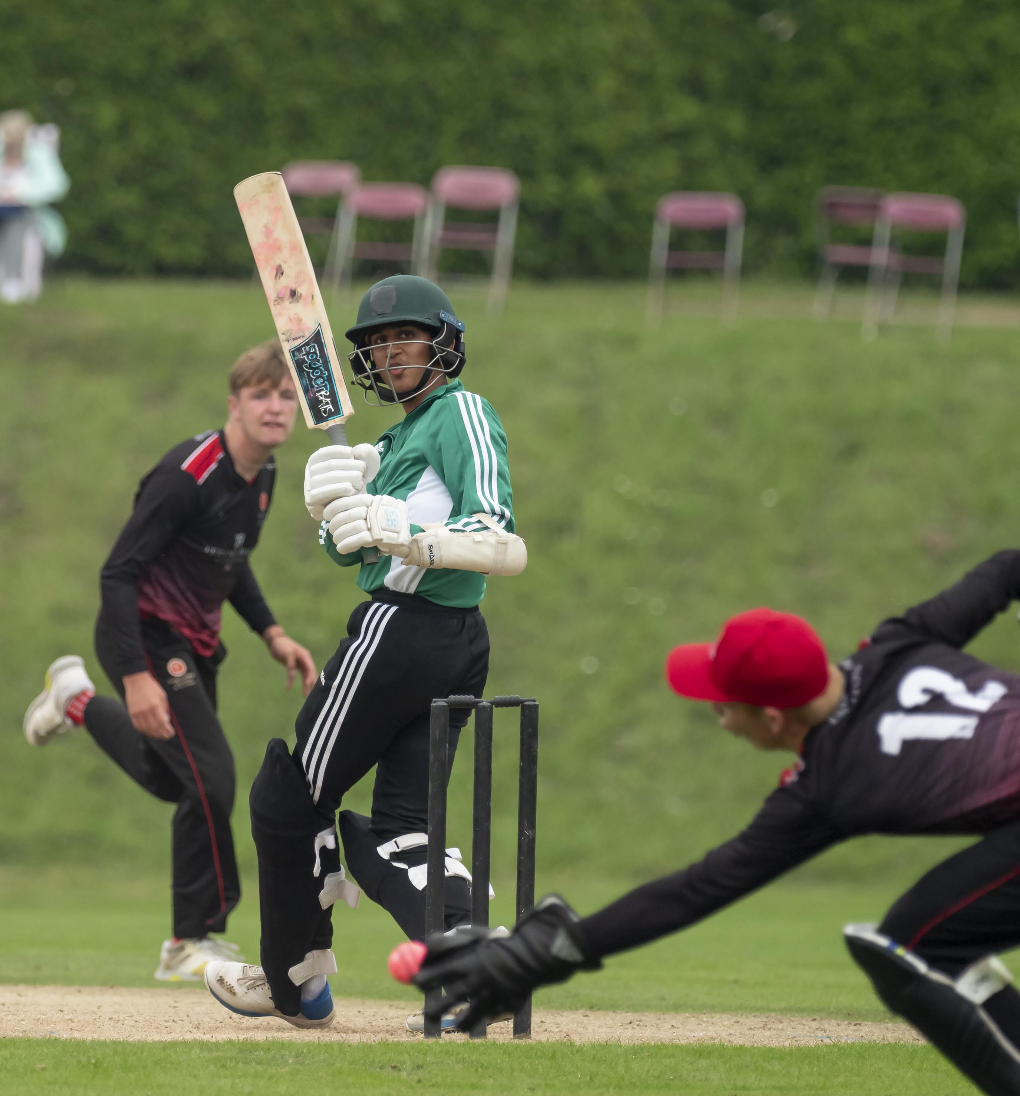
Rehaan Edavalath edges a ball past James Rew

Slide 19
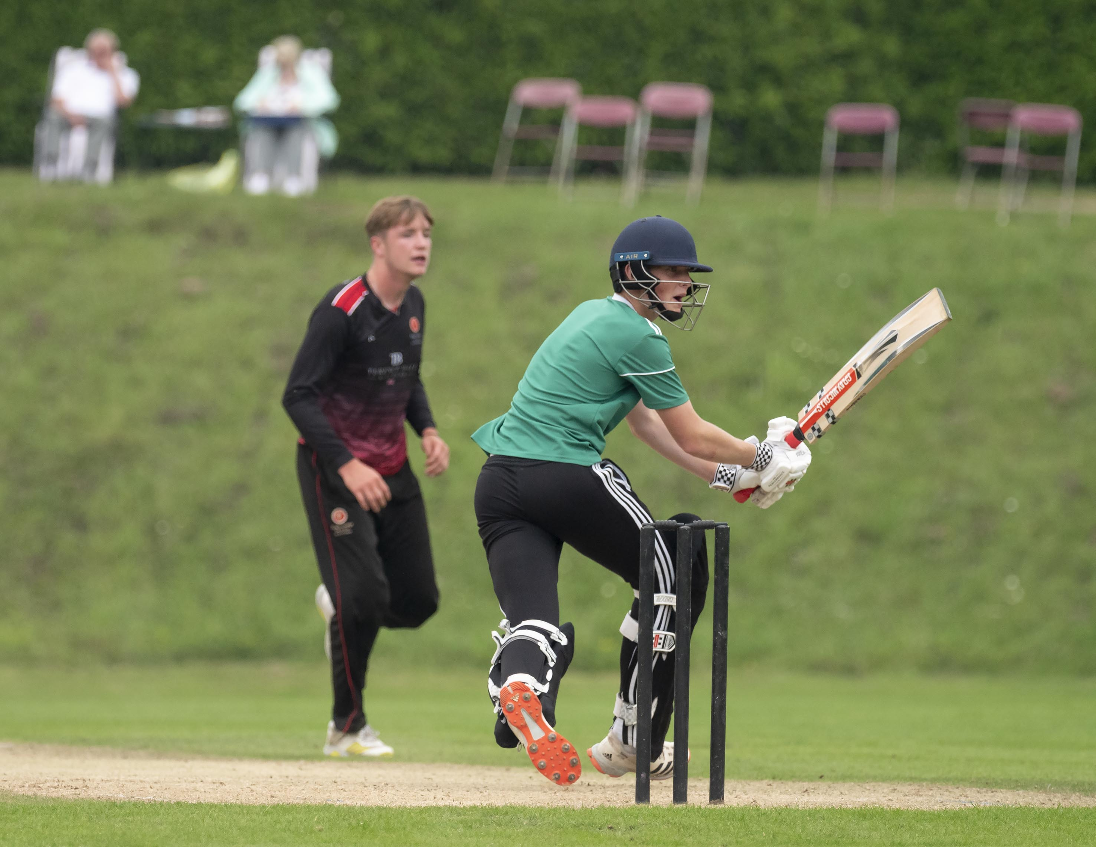
Tom Boorman, Malvern’s top scorer (62) batting

Slide 20
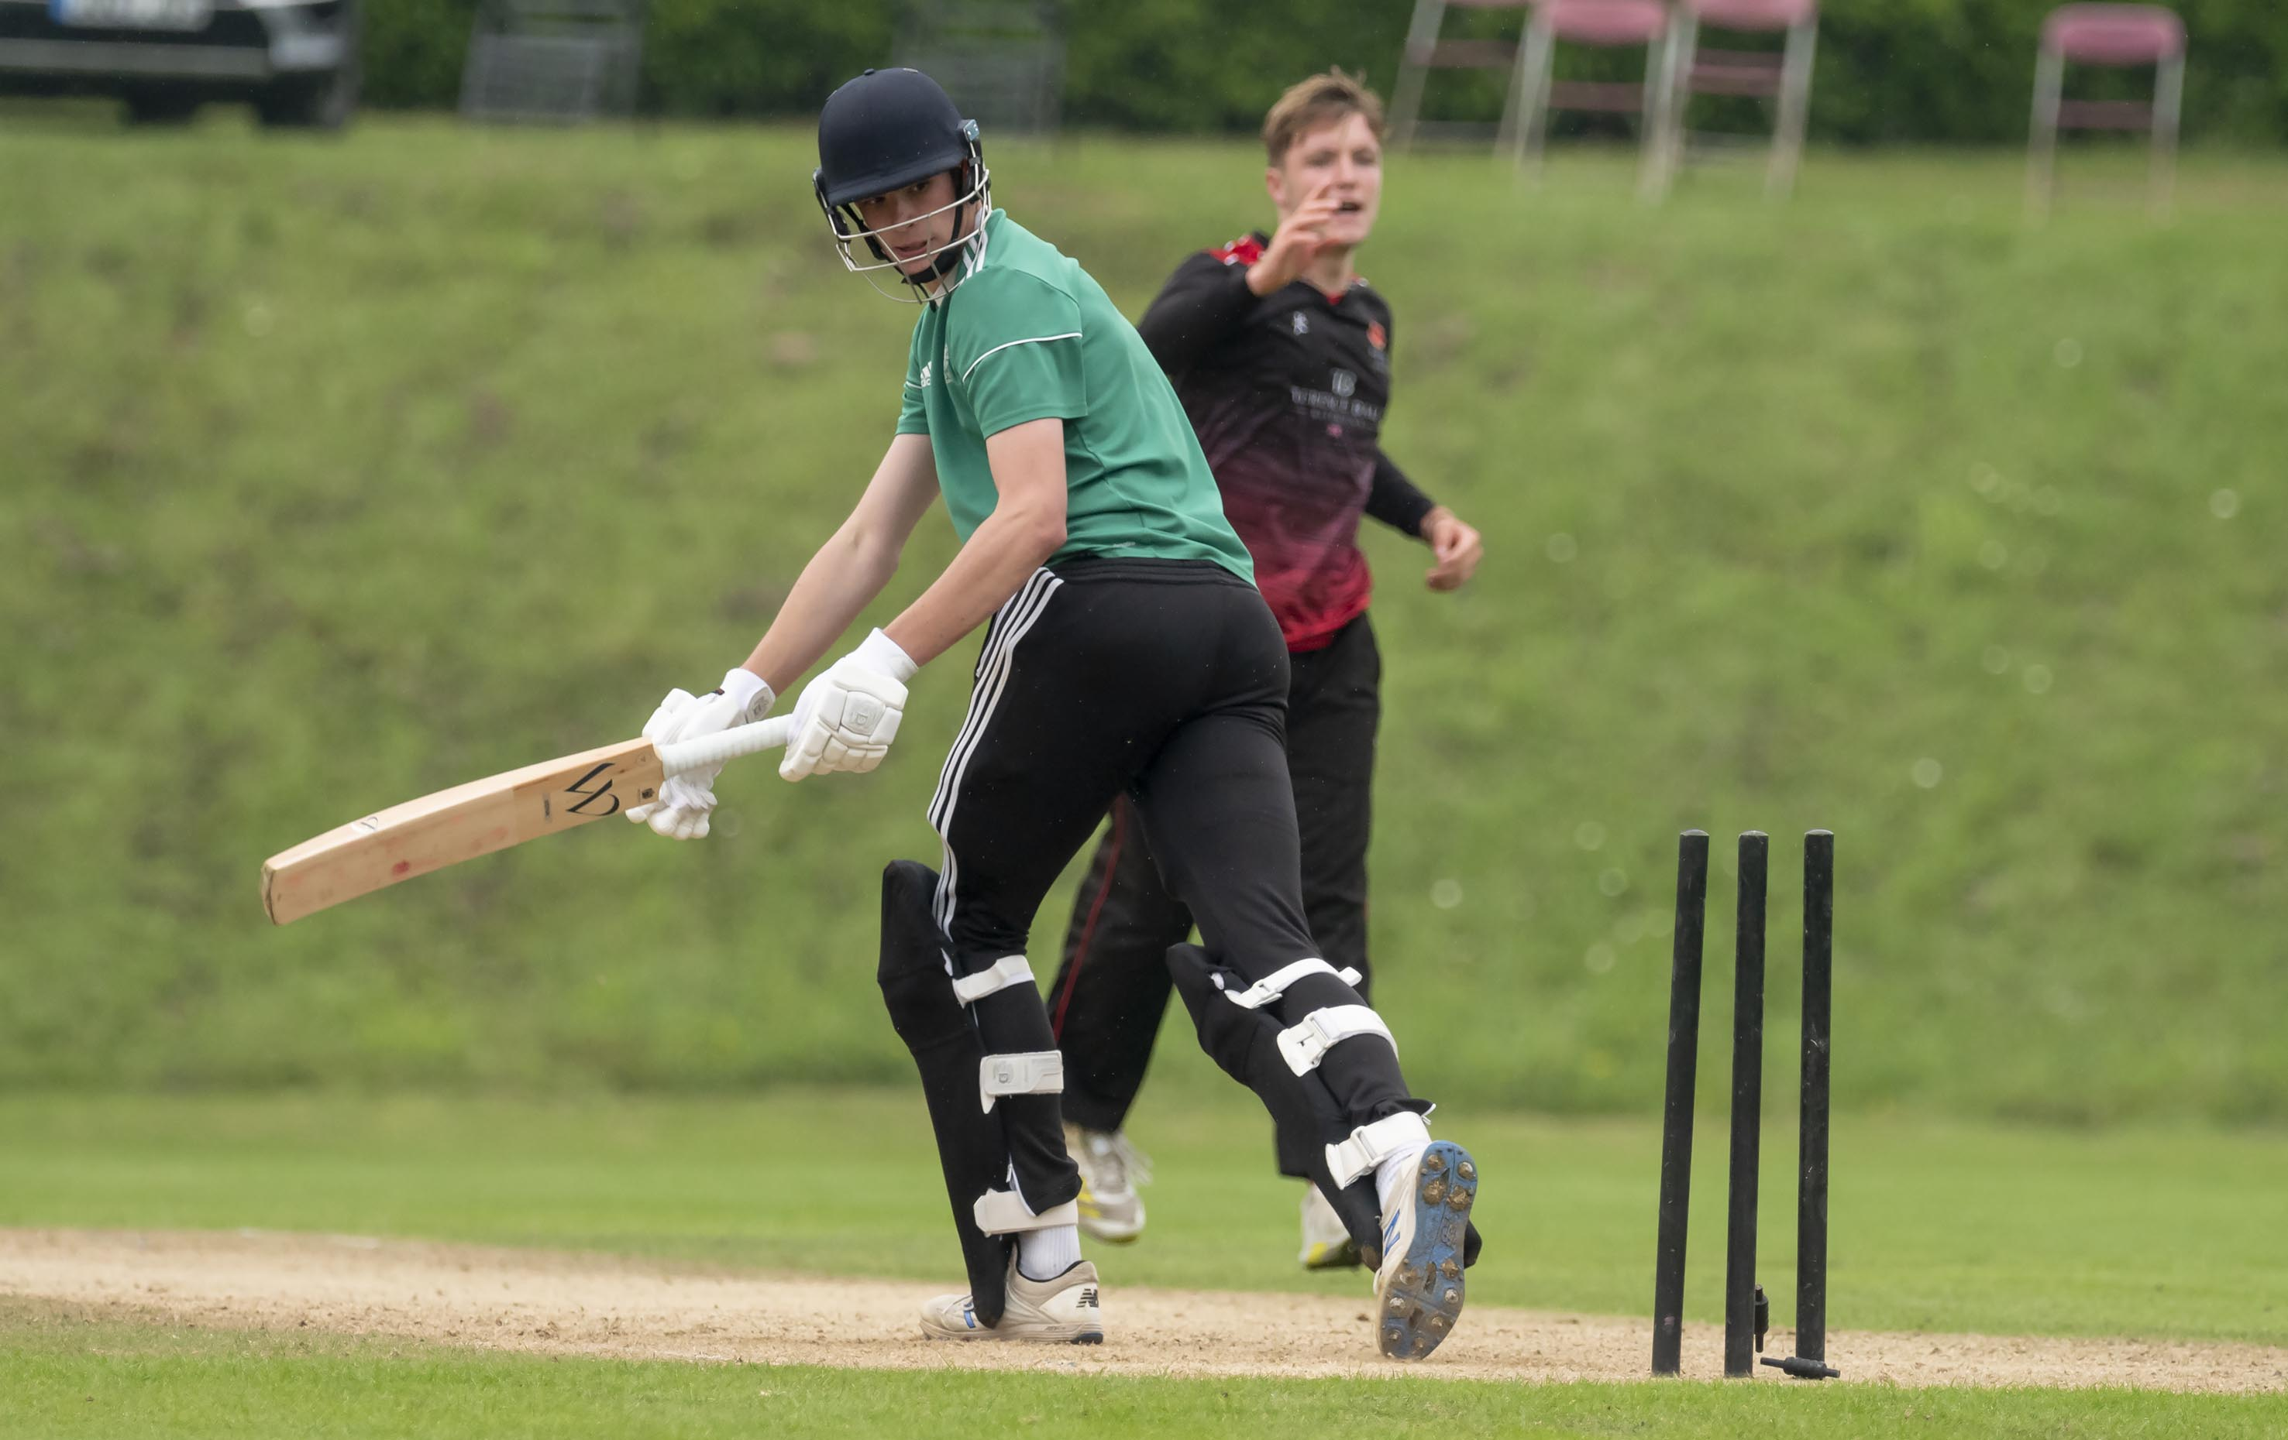
Josh Baker bowled by Charlie Sharland for 7

Slide 21
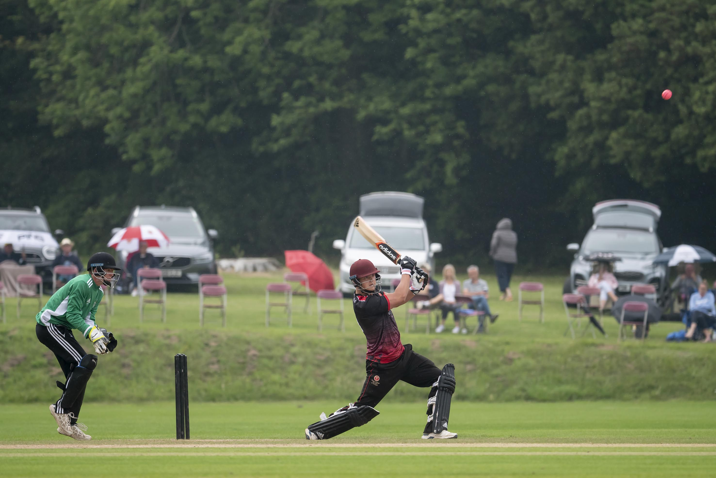
George Thomas drives during his 18

Slide 22
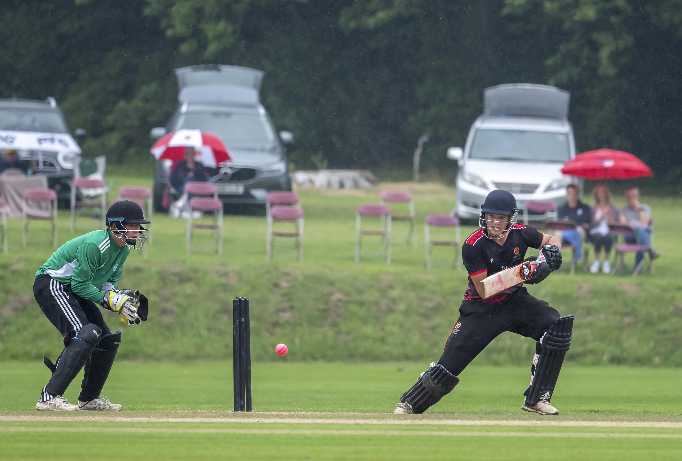
Henry Smeed cuts during his 45

Slide 23
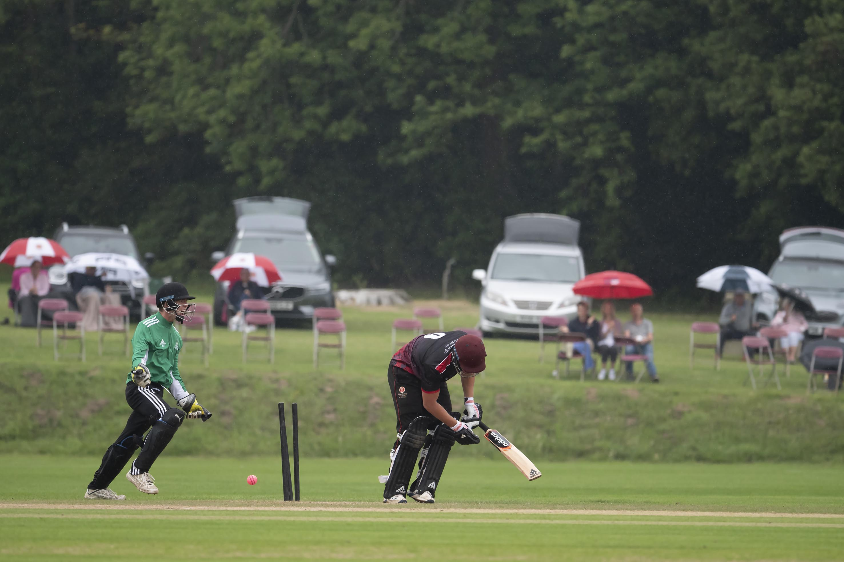
George Thomas is bowled by Josh Dickenson for 18

Slide 24
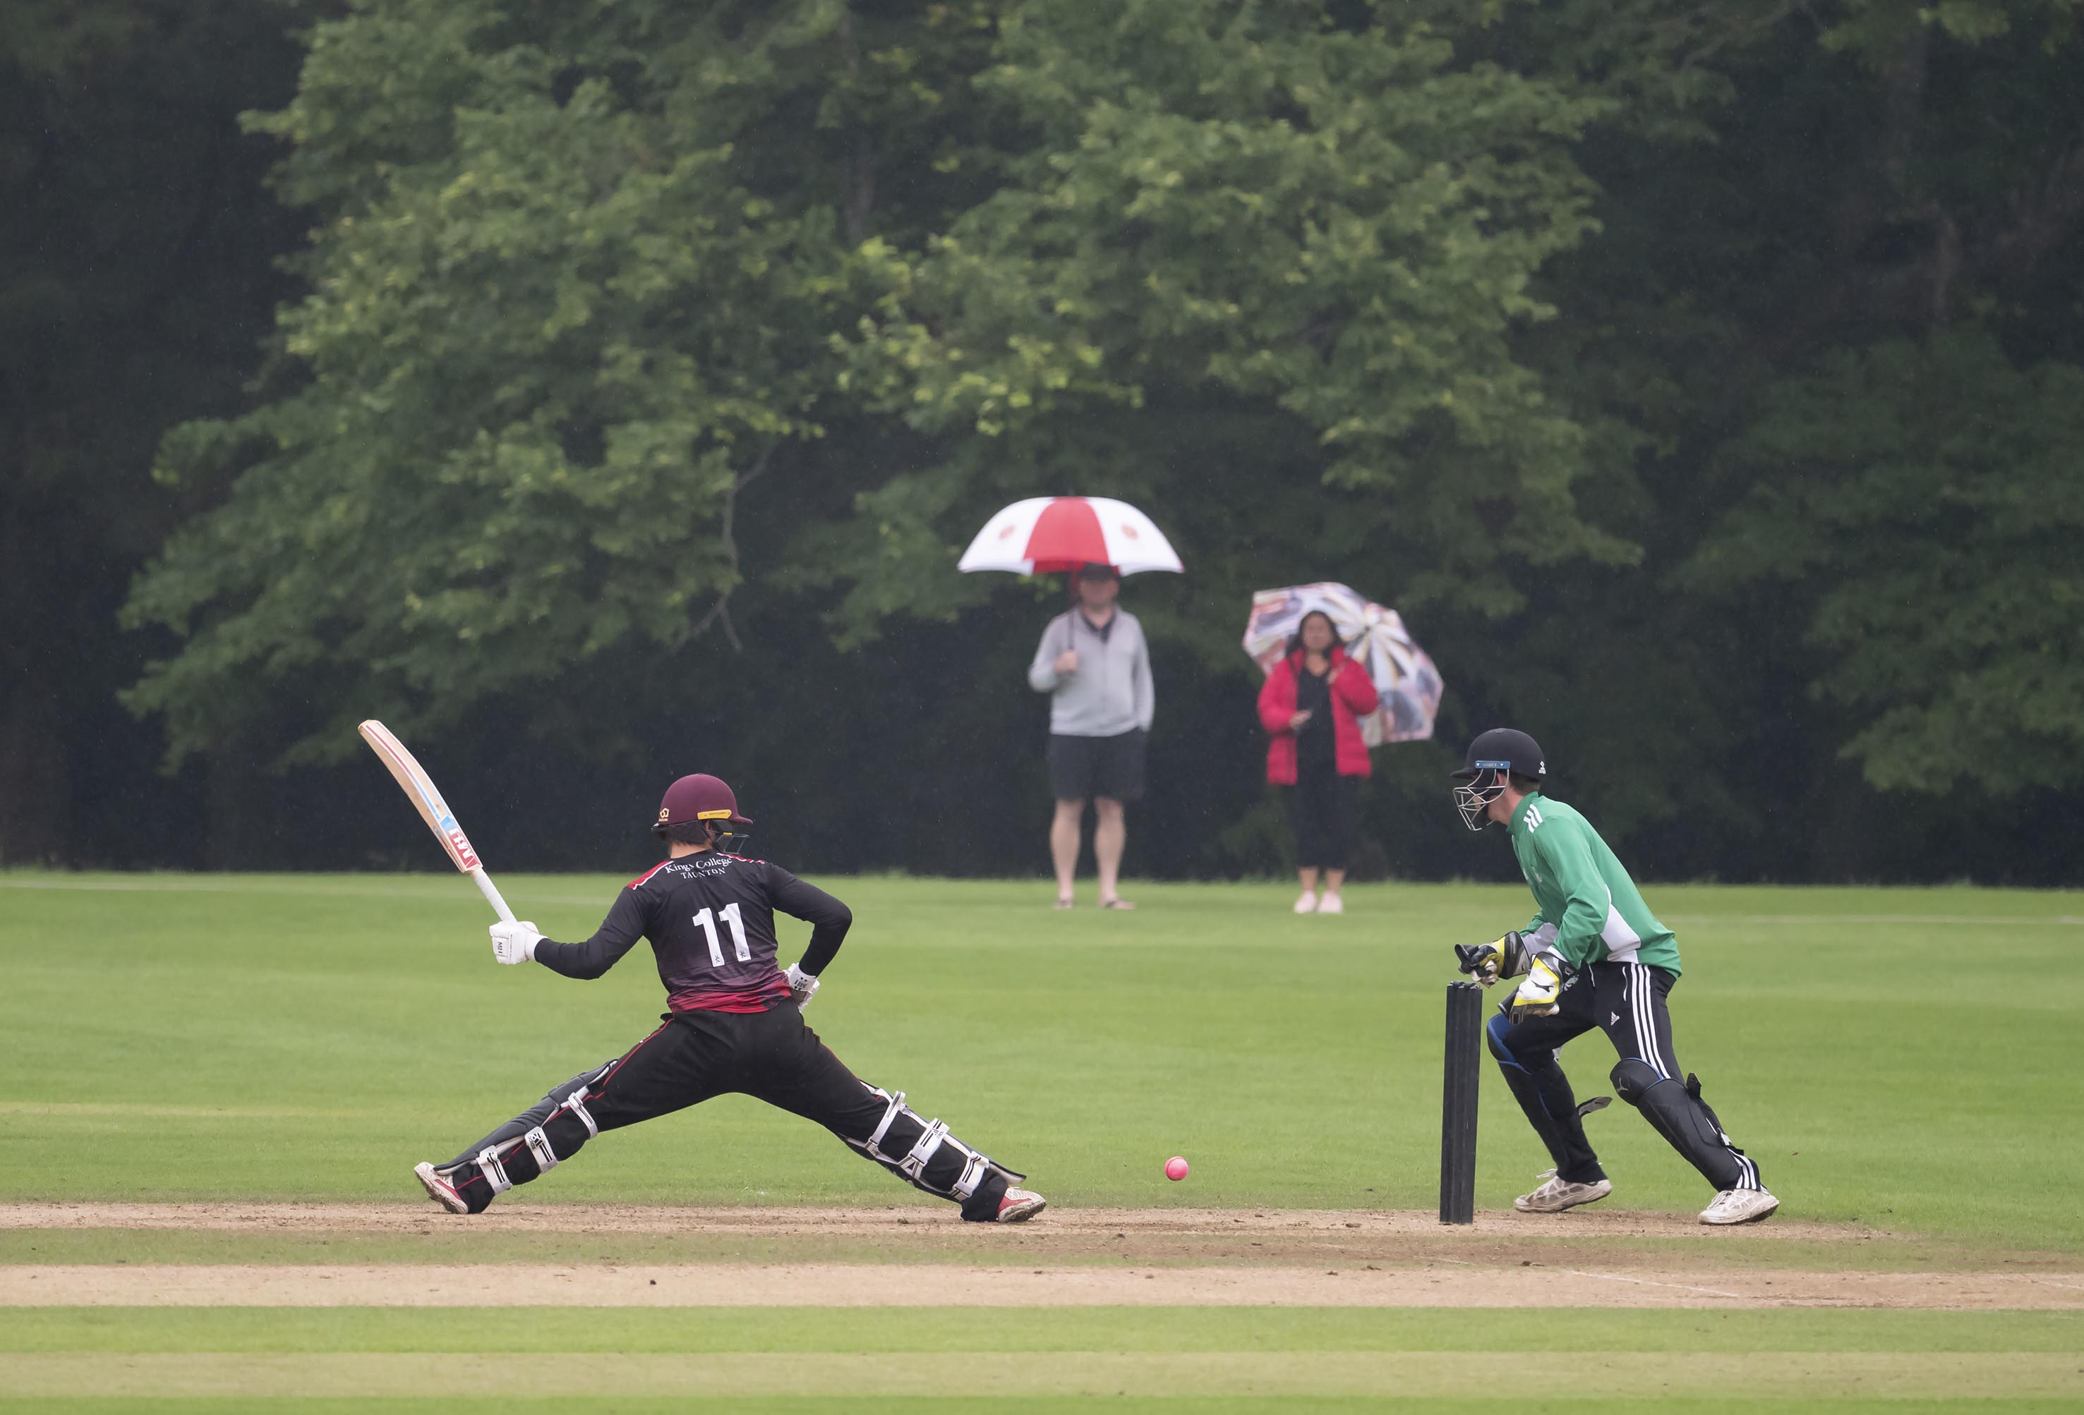
King’s captain Taylor Ingham Hill offers a stumping chance as the rain begins

Slide 25
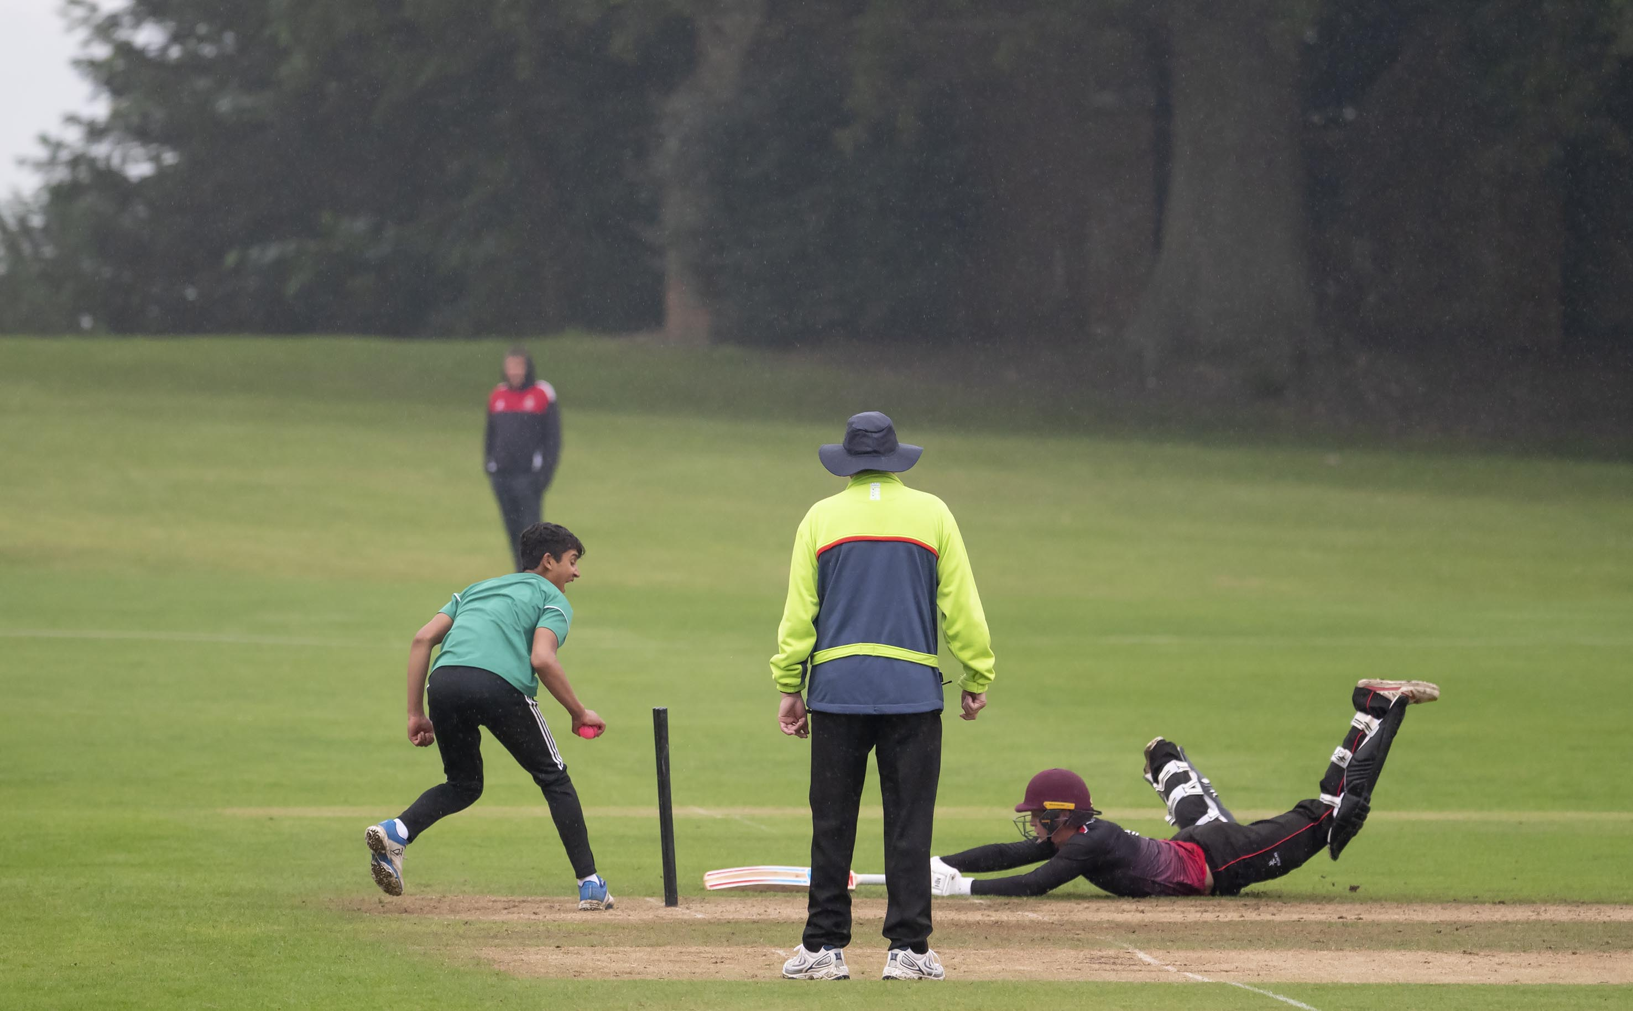
Taylor Ingham-Hill, King’s captain is run out for 18; his conduct resulted in a five run penalty

Slide 26
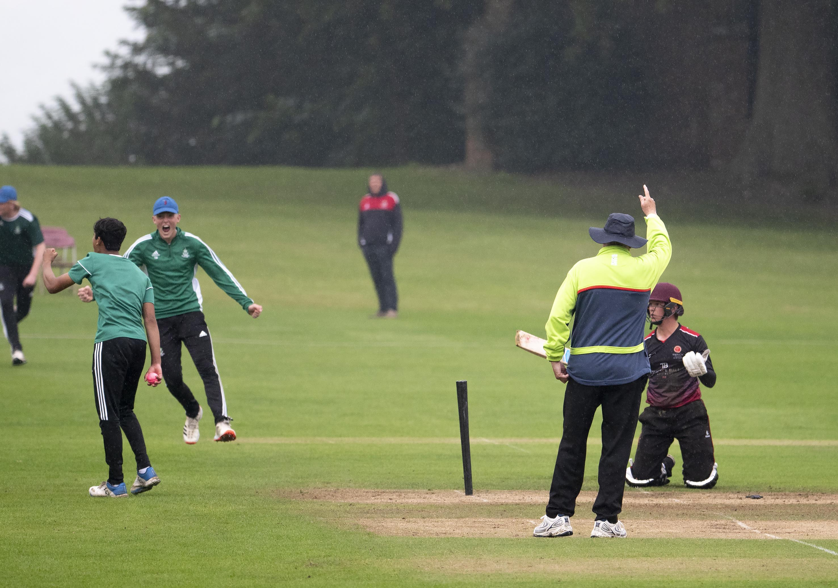
Taylor Ingham-Hill is given run out for 18

Slide 27
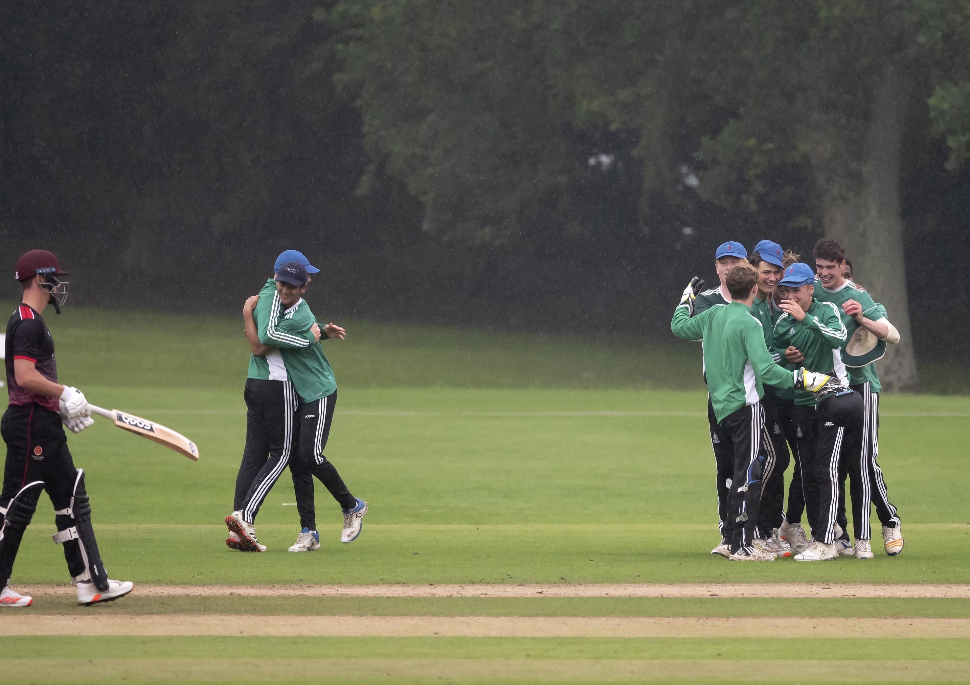
Malvern win, in pouring light rain

Slide 28
The presentation
by
Andy Whittall
Chairman, Schools Cricket
Former Test and One-day player for Zimbabwe

Slide 29
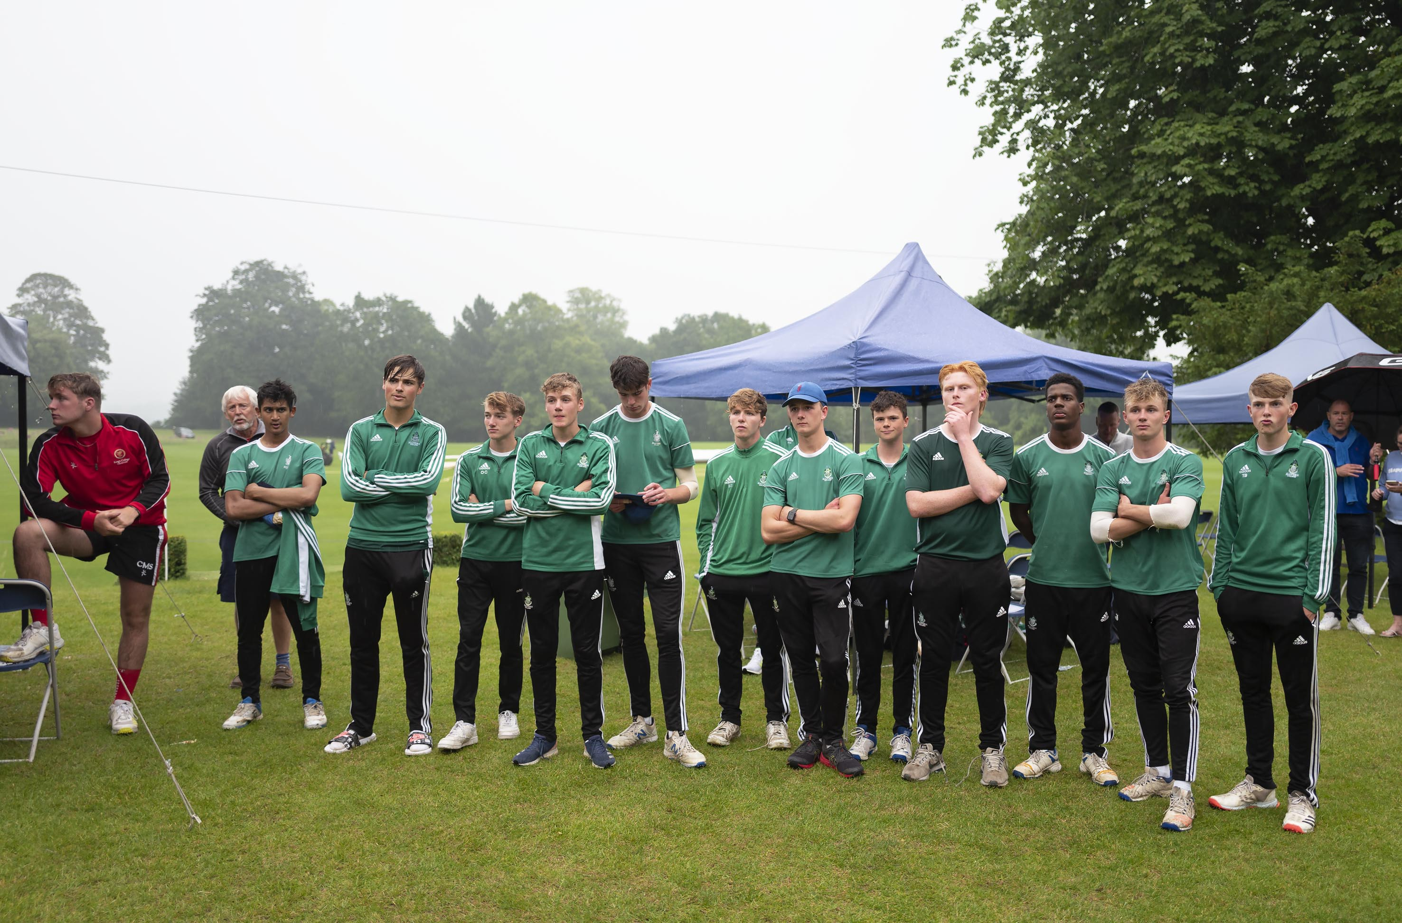
The Malvern team who retained their Trophy pose in the rain

Slide 30
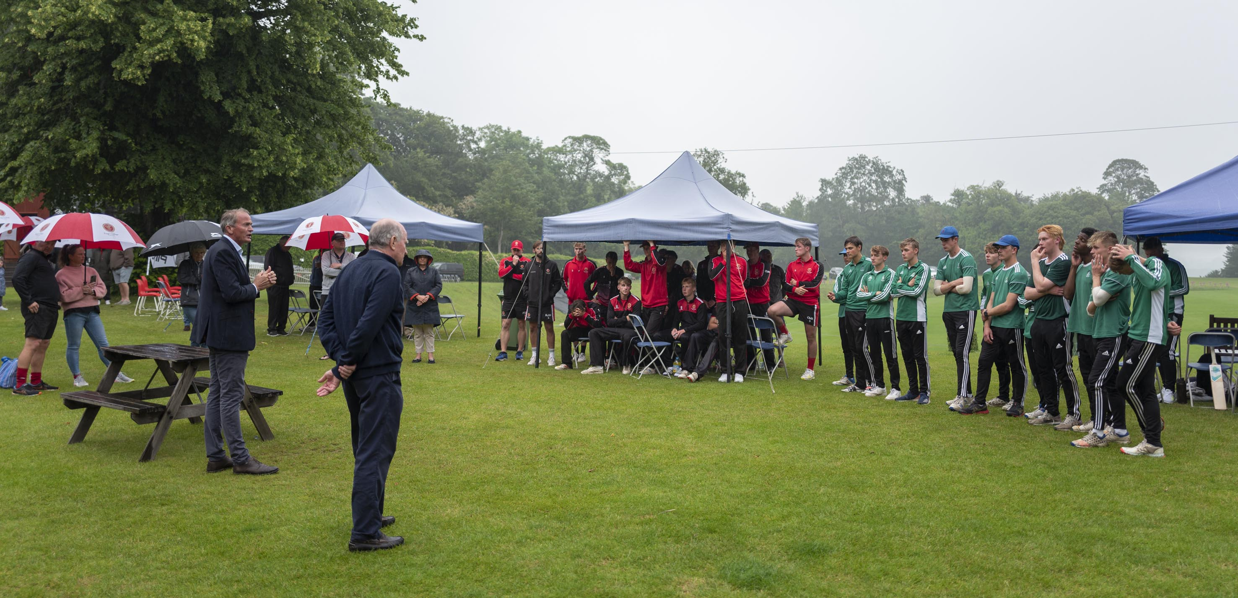
The presentation to winners Malvern (right) 2021

Slide 31
Malvern captain Josh Dickenson receives the Trophy from Andy Whittall

Slide 32
Malvern win the National Schools T20 final for the second successive time
2021

